Slide 1
Symbolic Computation Using Big Data Deliverables
By Ted Nguasong
Ted CTEC 298-101 Nguasong

Slide 2
Contents
Introduction
Summary of Ctec 128
Dataquest Python for Data Scientists
Jupyter Notebook
Plot Tutorials
Final Data Wrangling, Cleaning, and plots
References

Slide 3
Introduction
Data plot/visualization deliverable on CTEC 128 final project
3 repositories, Google Share drive, Jupyter Notebook, Github
Applications used
Jupyter Notebook
Github
Google Drive

Slide 4
Summary of ctec 128
Main Objective:
To Determine whether a person's demographics, educational Attainment and location impact their unemployment Status (Pre-COVID)
Main Research Question:
Can we determine a person’s race, age, sex, education attainment, or location factors contribute to their unemployment?

Slide 5
PURPOSE
To analyze data for possible factors that impact a person's likelihood of unemployment inside the United States in 2019.

Slide 6
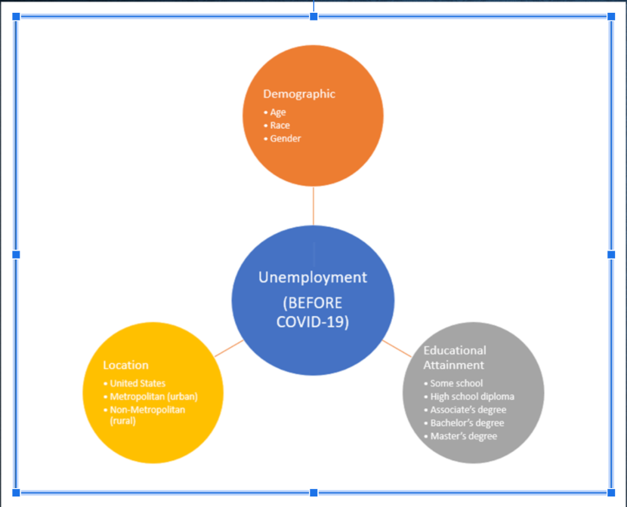
Concept Map

Slide 7
DATA INGESTION
Data Source: Current Population Survey (2019 monthly)
ASEC monthly CPS IPublic Use Microdata files collected from 50,000+ households interviewed/ called and downloaded as .csv files from U.S. Census Bureau.
CO-sponsored by both the U.S. Bureau of Labor Statistics and the U.S. Census Bureau.
Data collected by CPS: once a month (19th) for 4 consecutive months, a year then repeats again for next year from a household.
CPS has been available to the public since 1962 to present
For state codes we used IPUMS
Instances: person file, household file
TOPICS: demographics status of population, family structure marital status, health, income, previous work experience, education, labor force participation rate

Slide 8
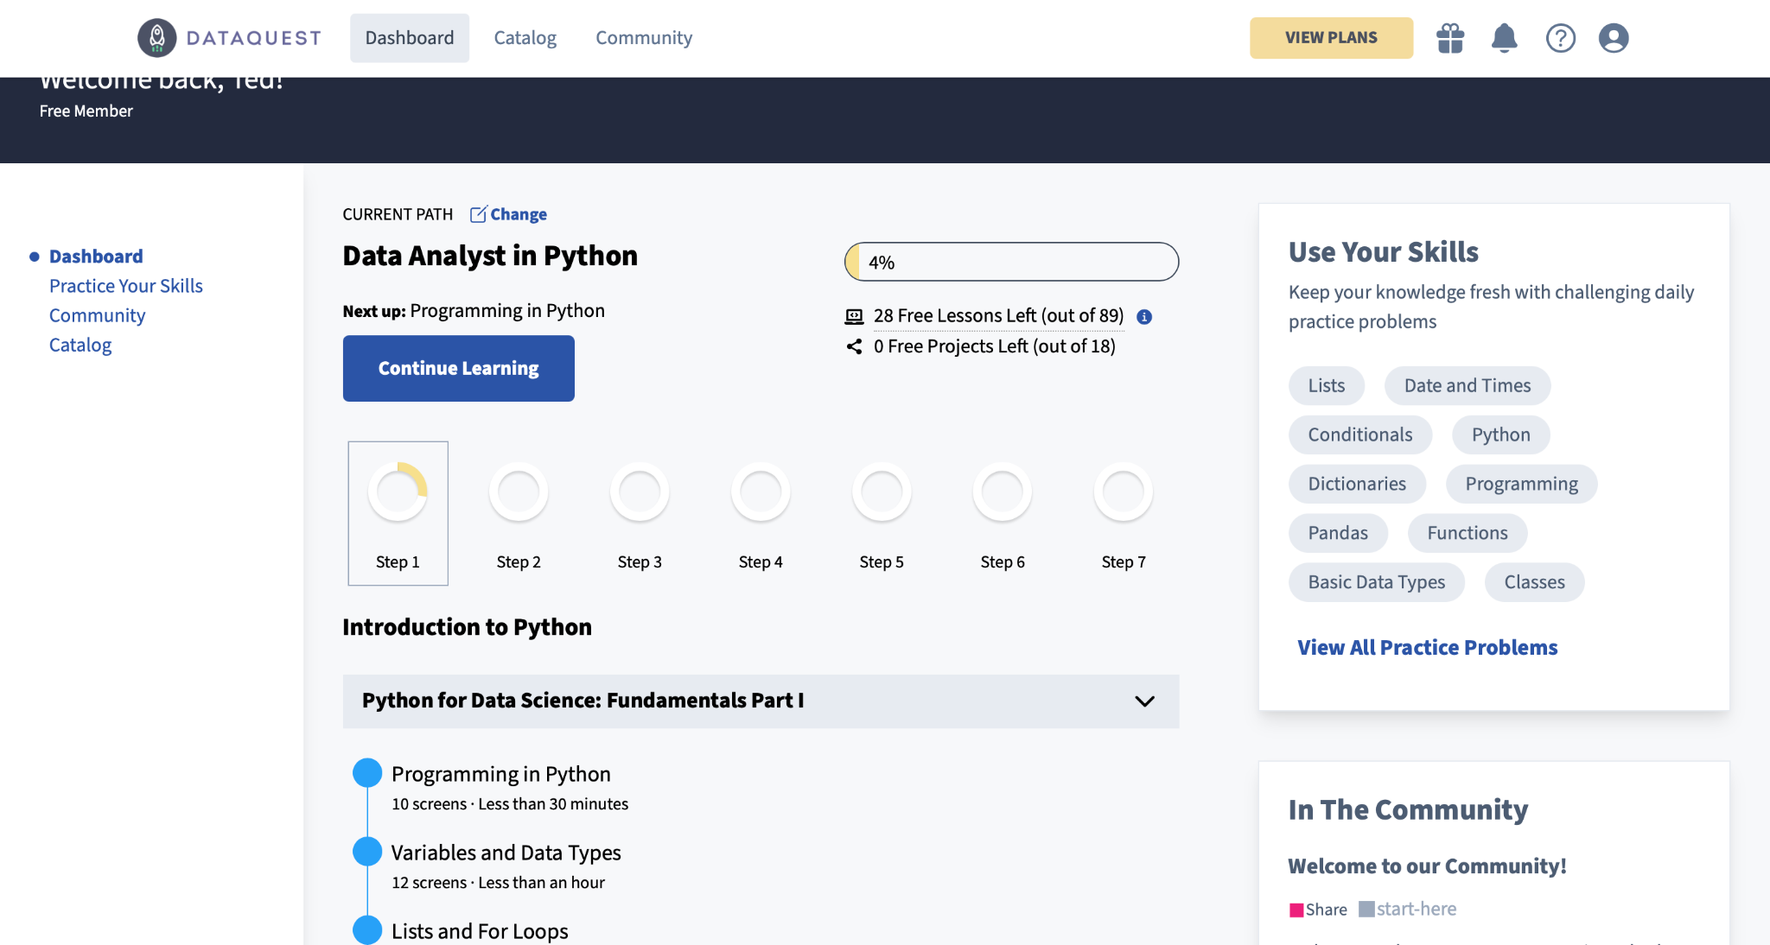
Dataquest Python for Data Scientists

Slide 9
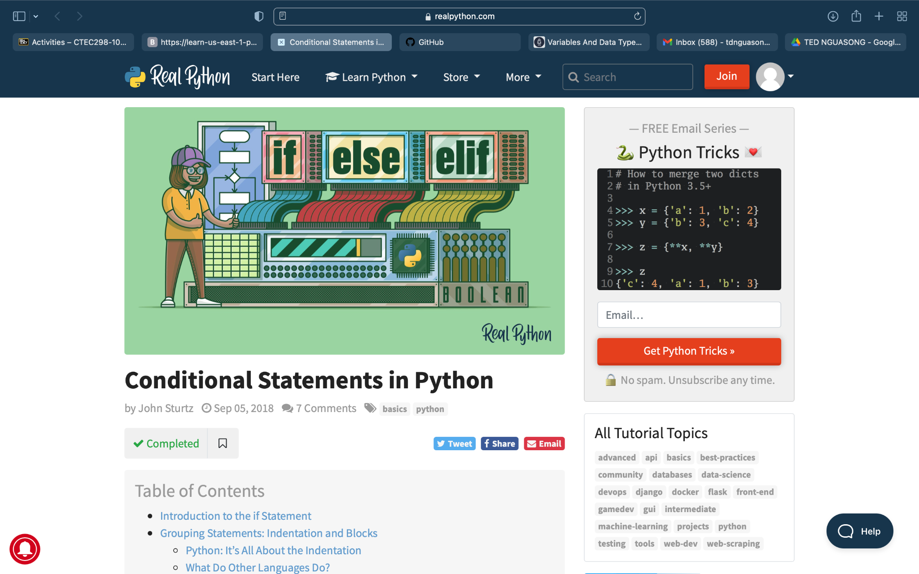

Slide 10
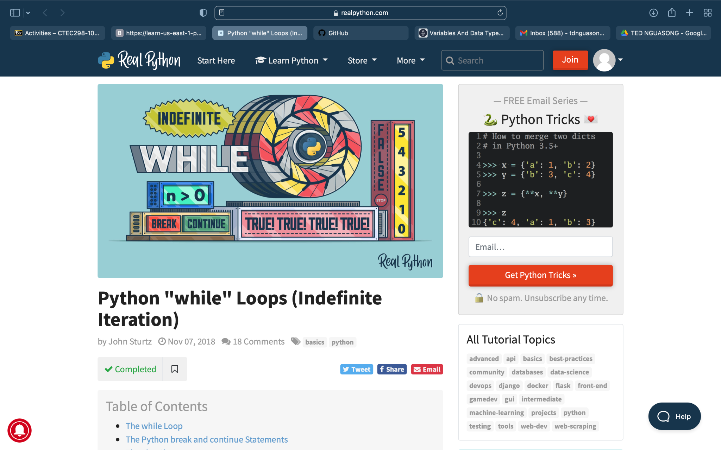

Slide 11
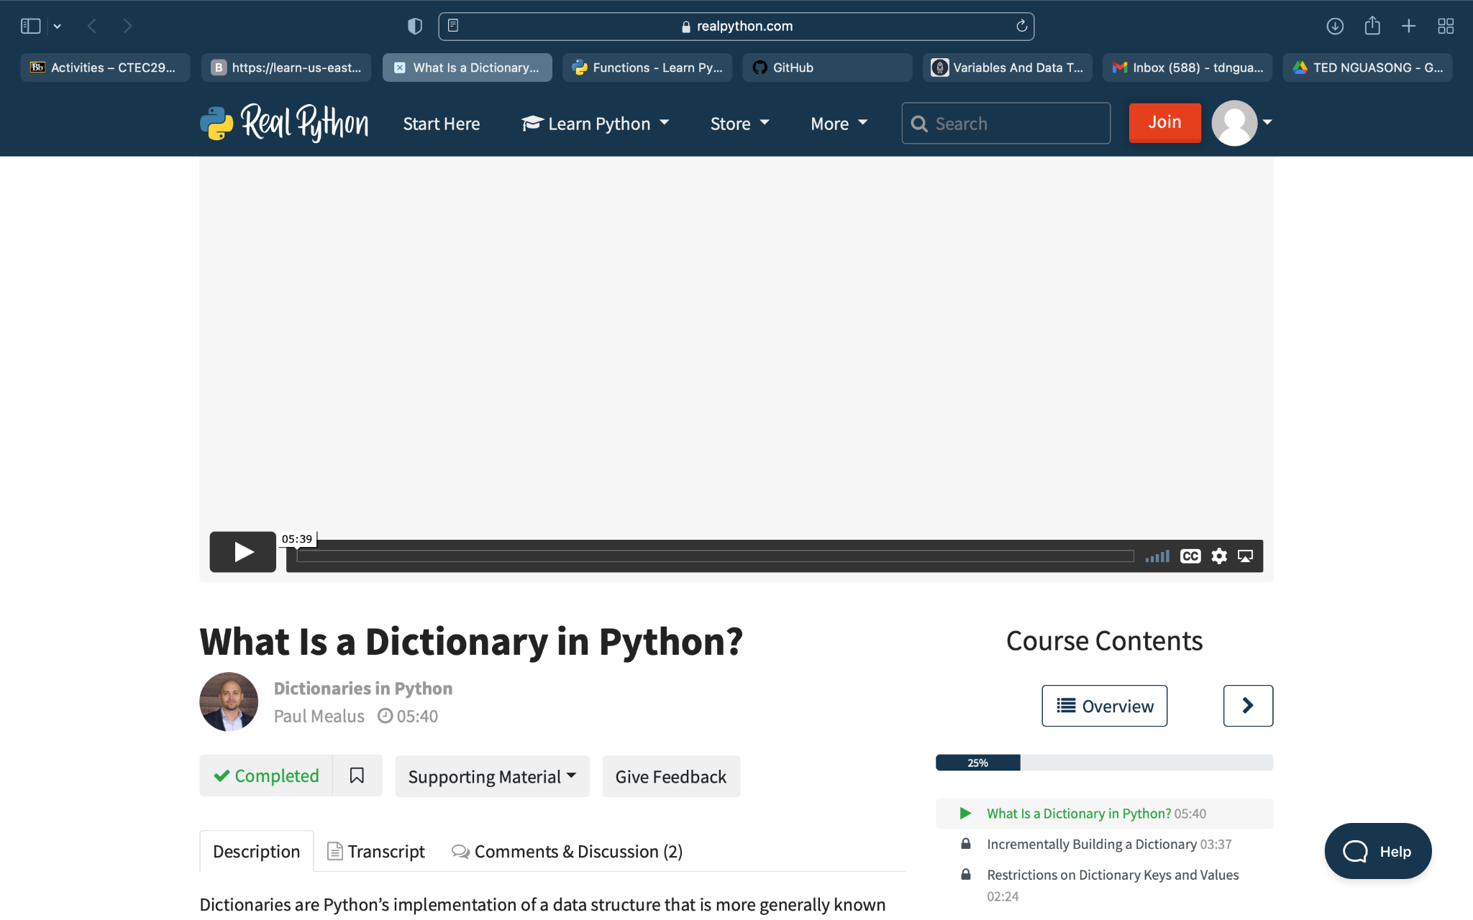

Slide 12
Jupyter Notebook
https://github.com/tednguasong/Jupyter-NoteBook.git

Slide 13
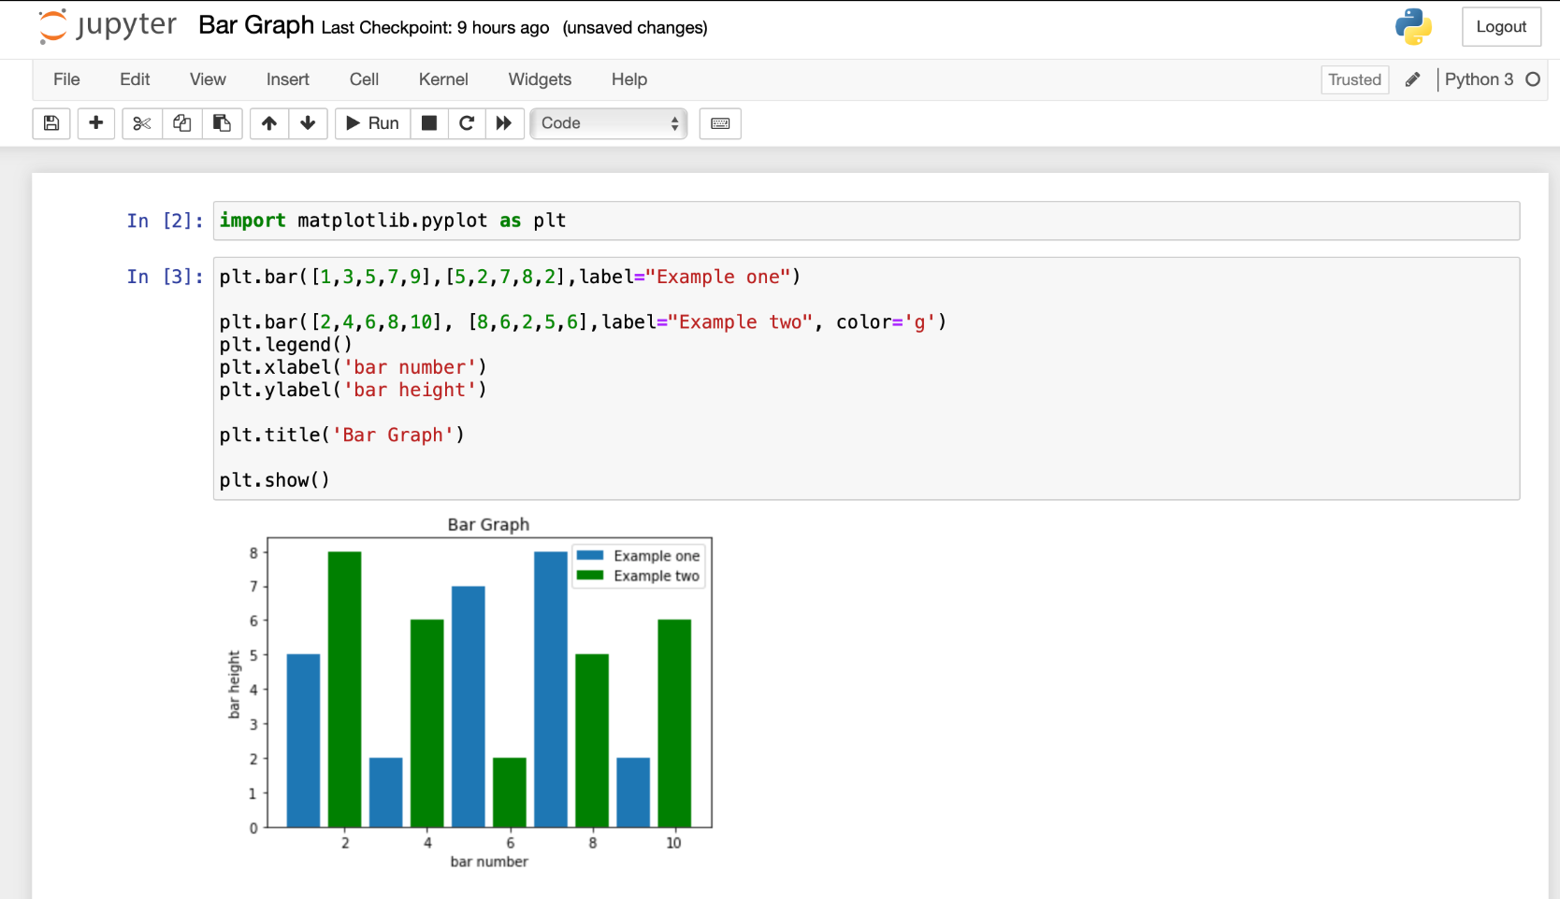
Bar Graph

Slide 14
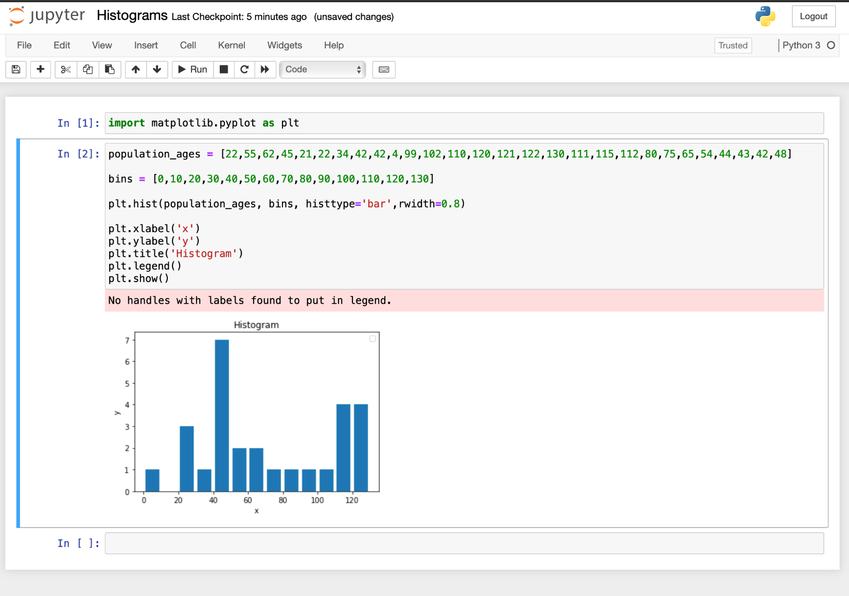
Histogram

Slide 15
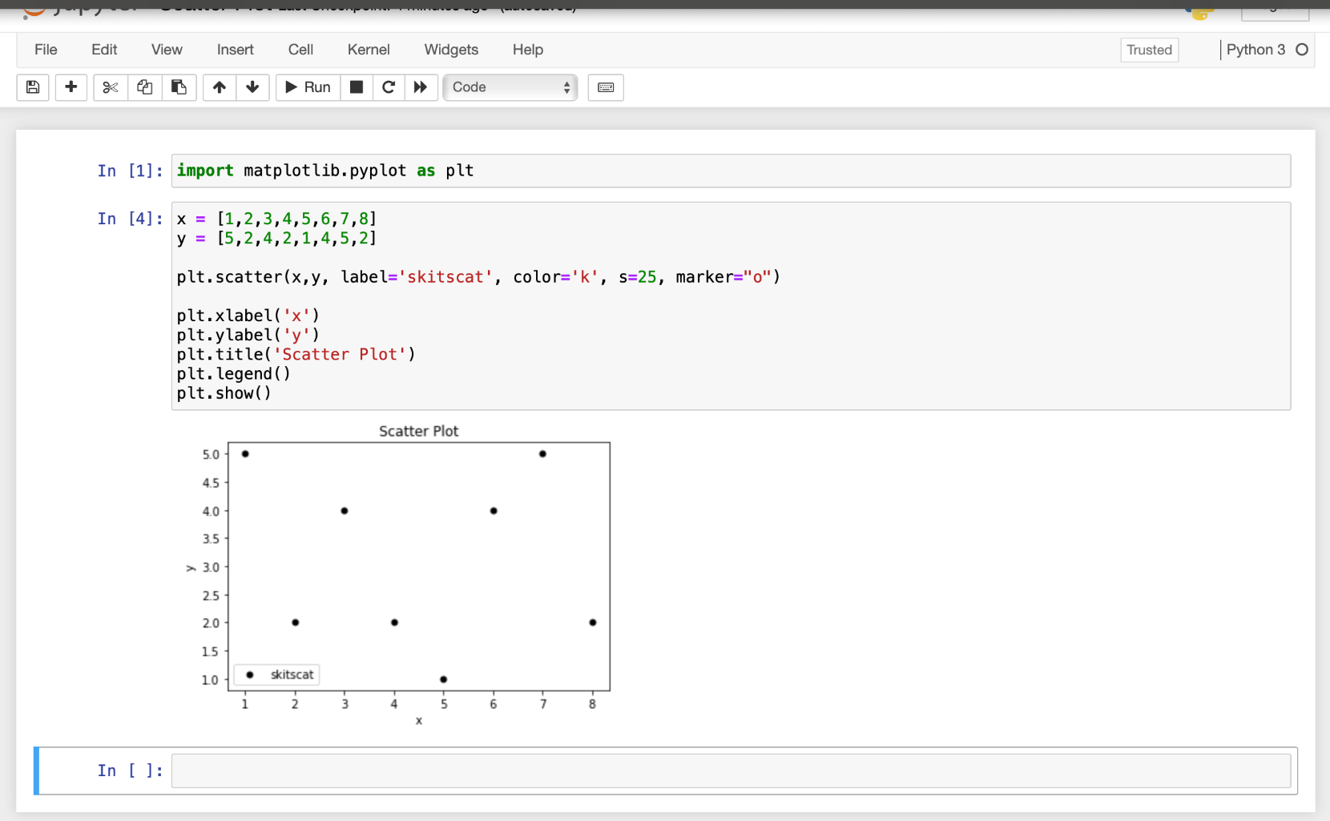
Scatter Plot

Slide 16
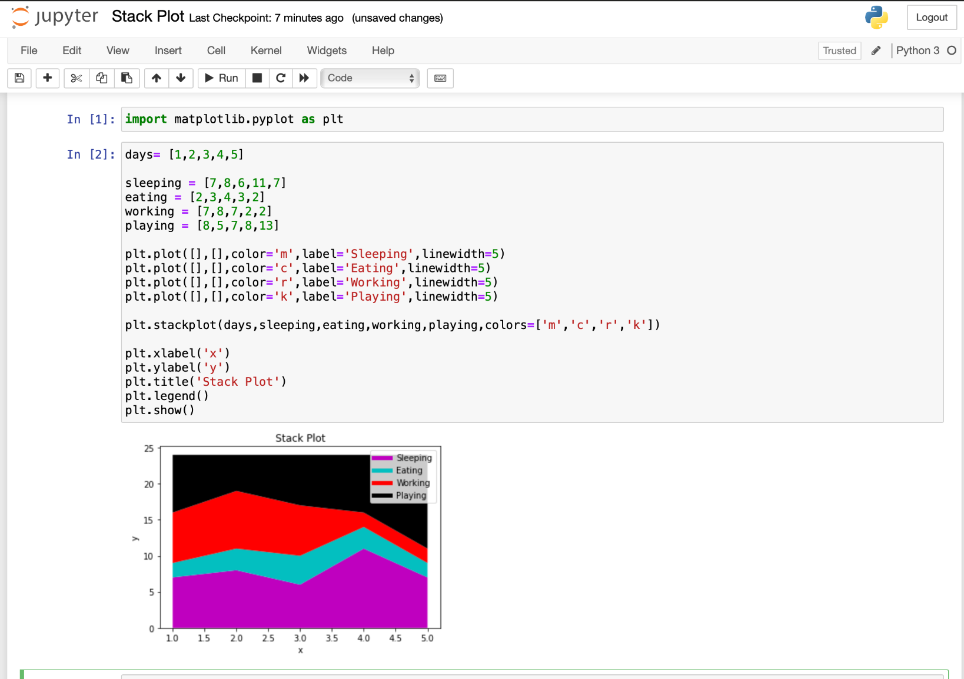
Stack Plot

Slide 17
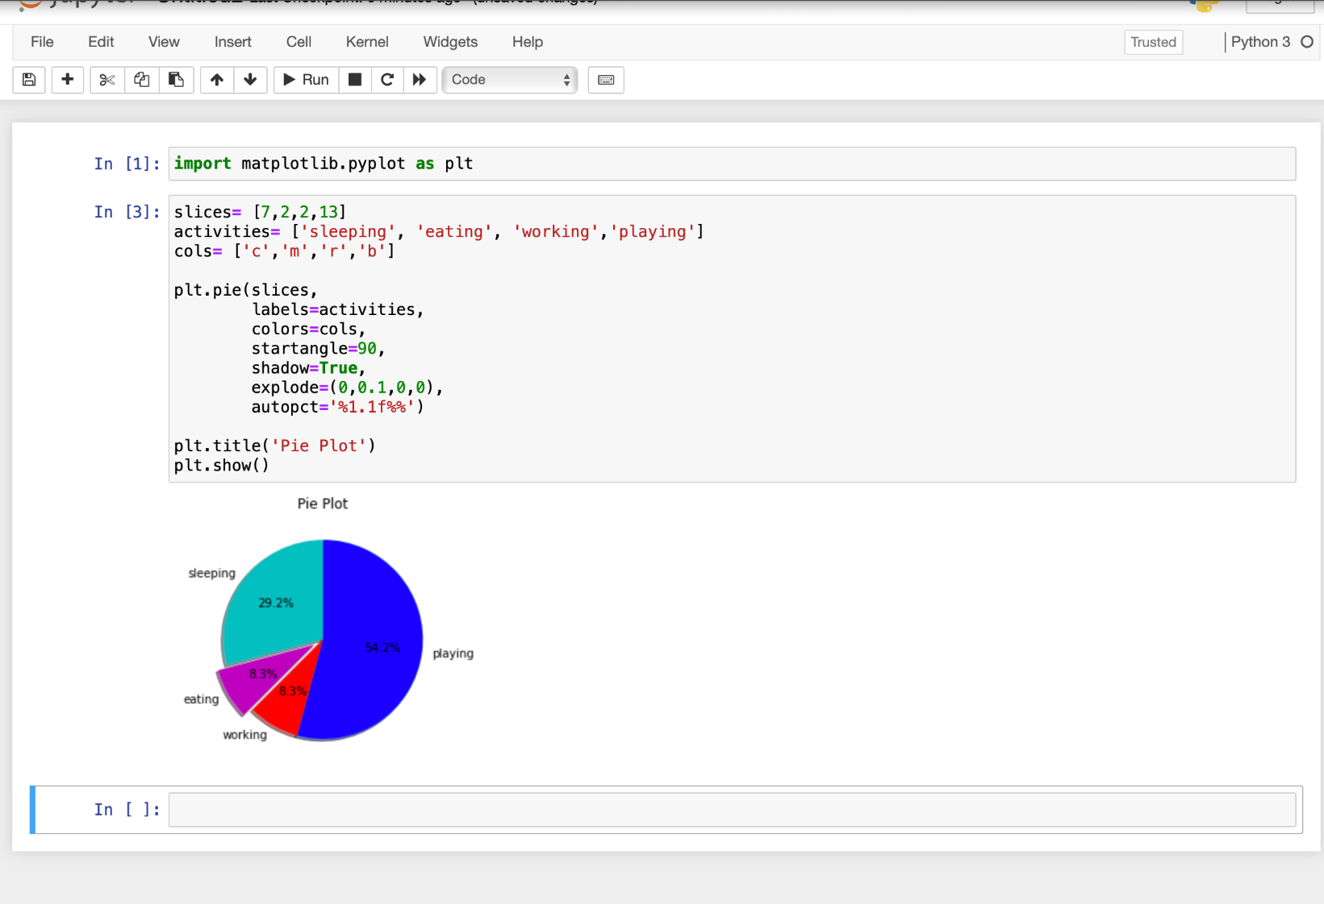
Pie Plot

Slide 18
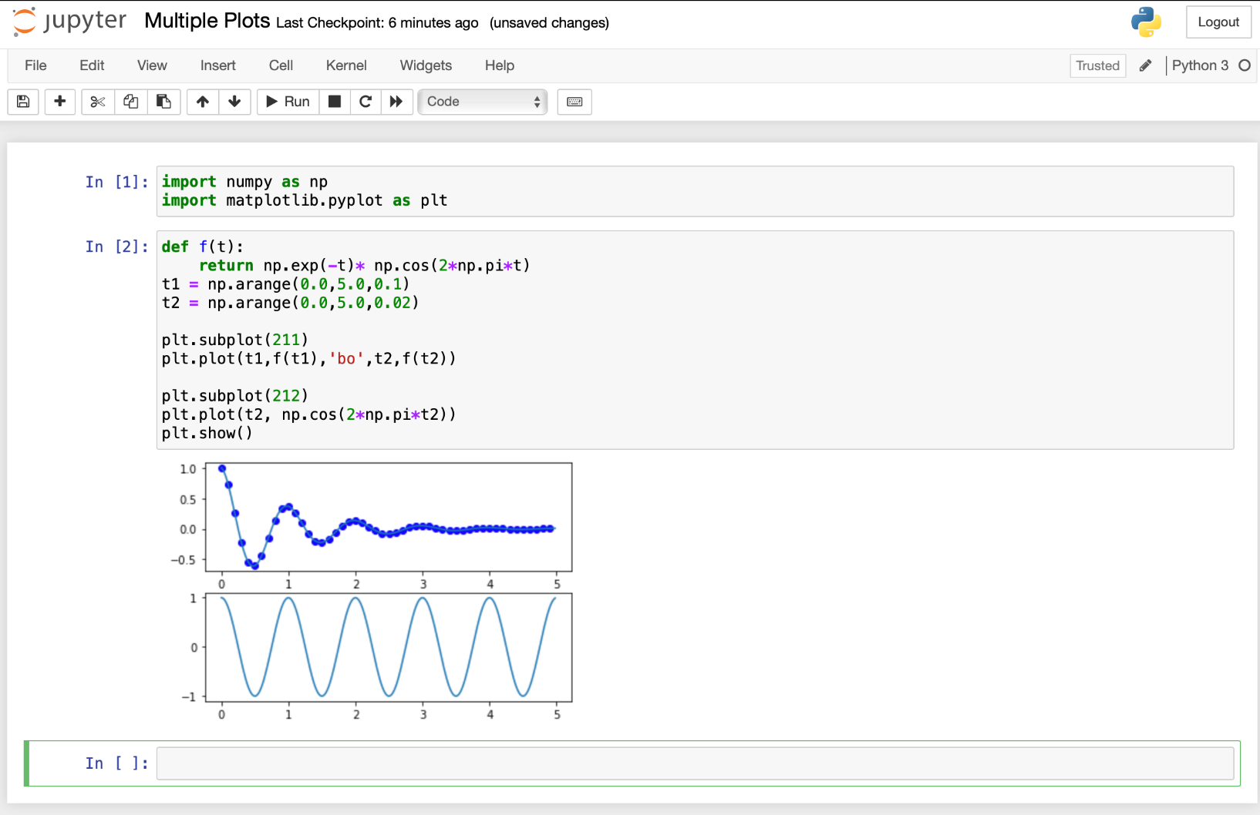
Multiple Plot

Slide 19
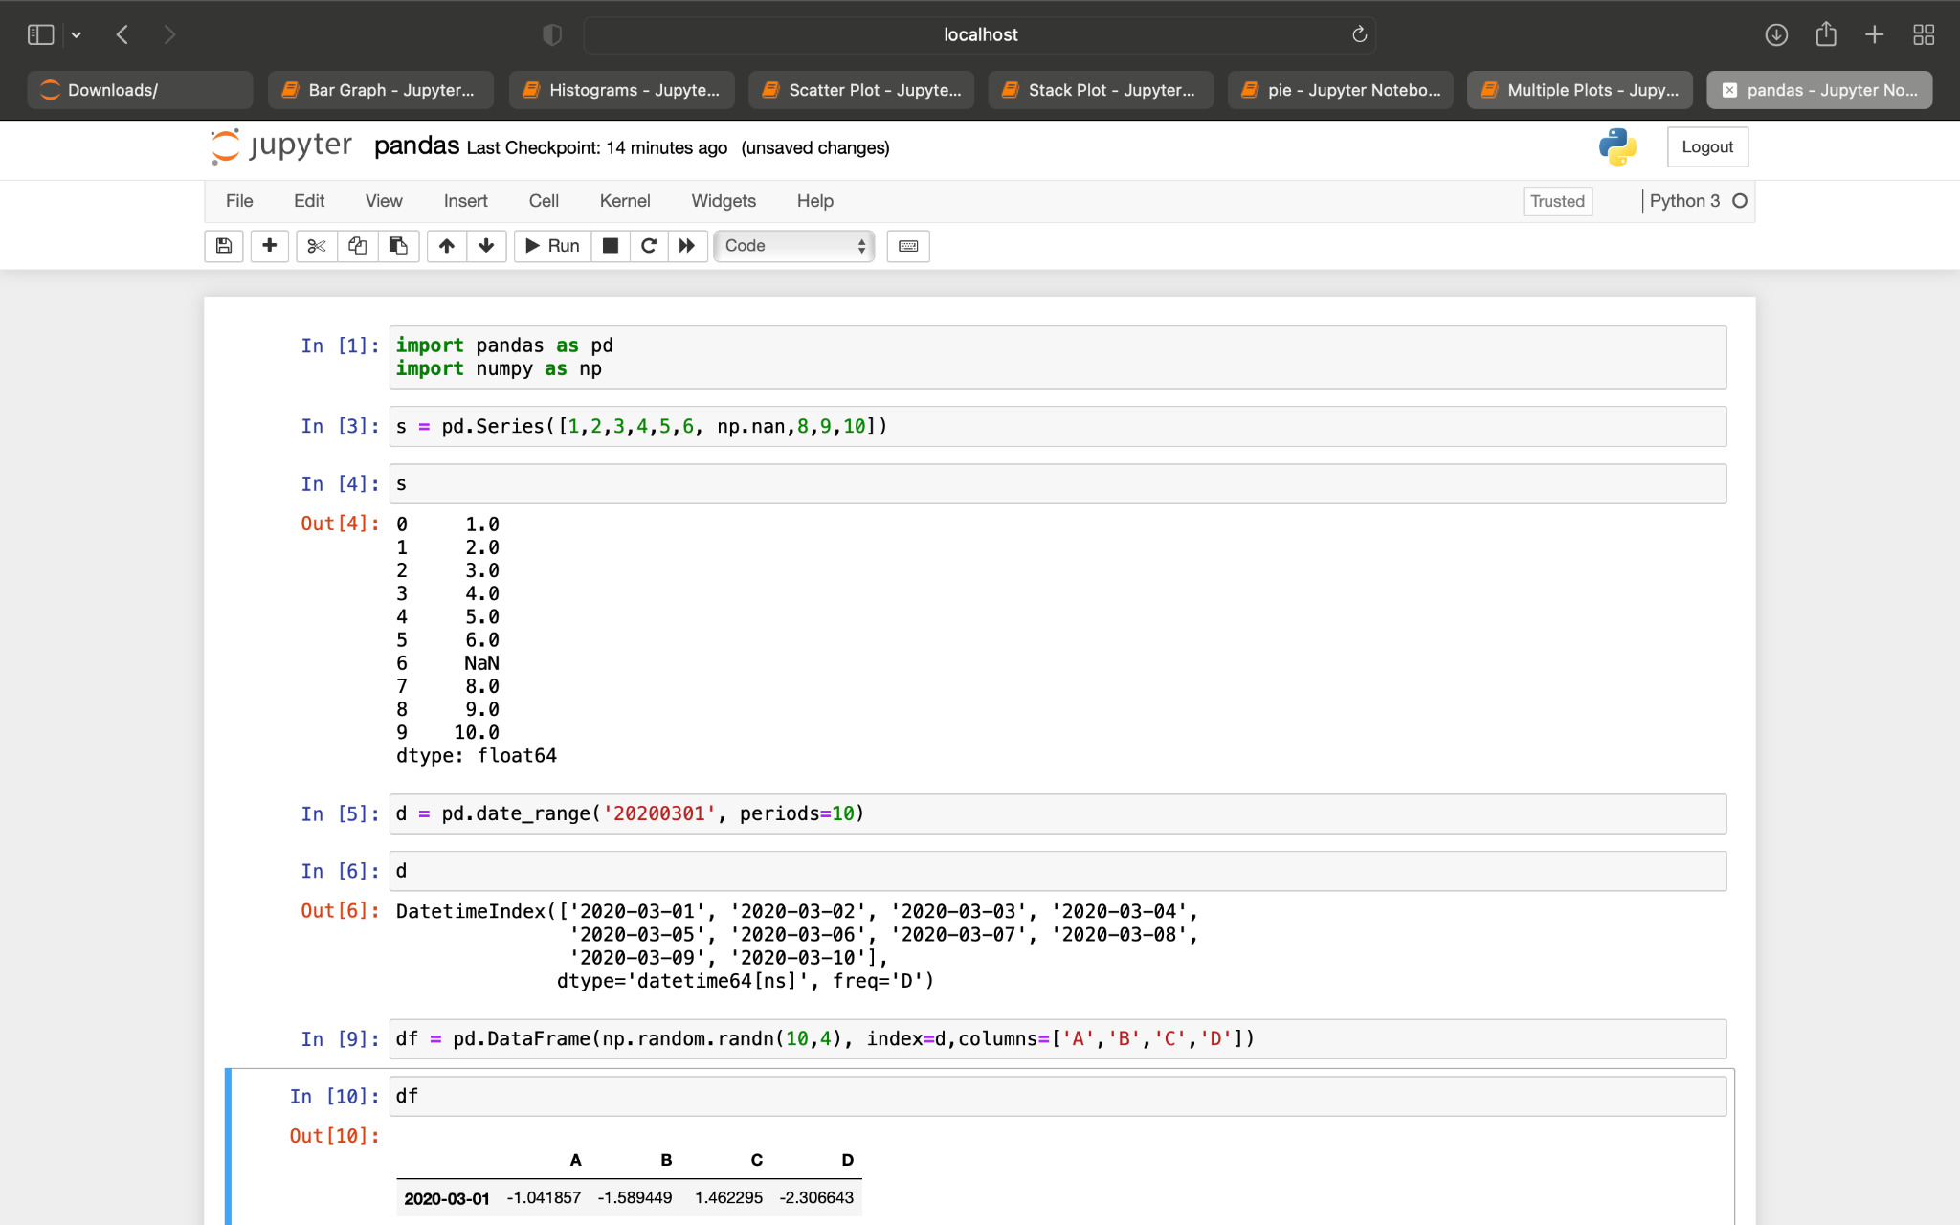
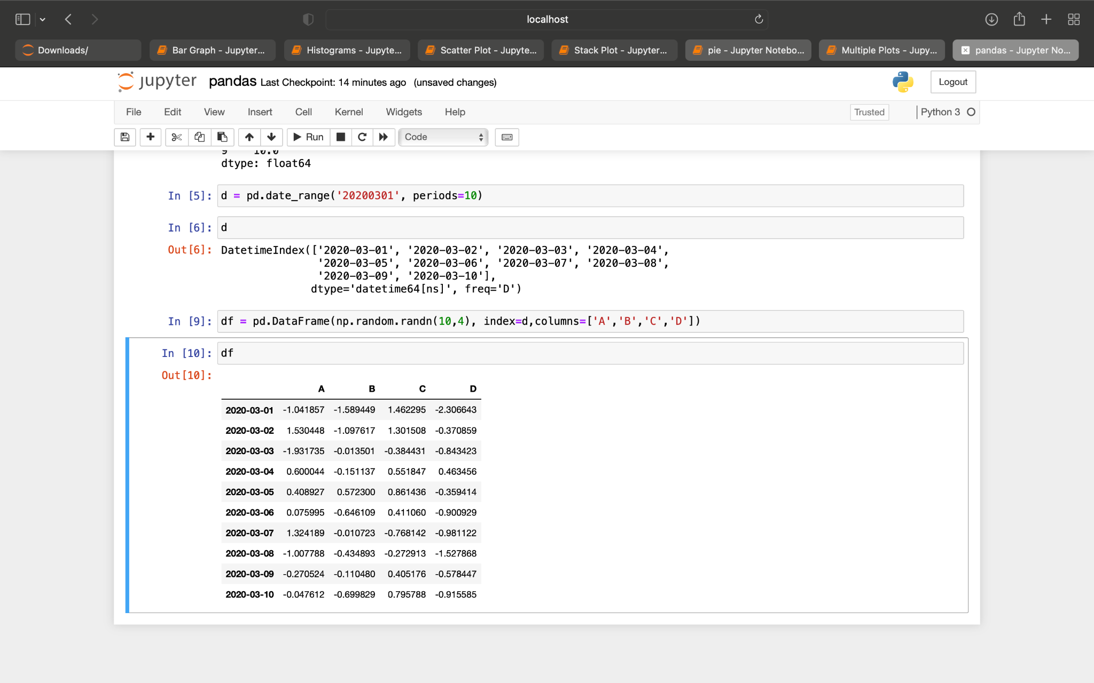
Pandas

Slide 20
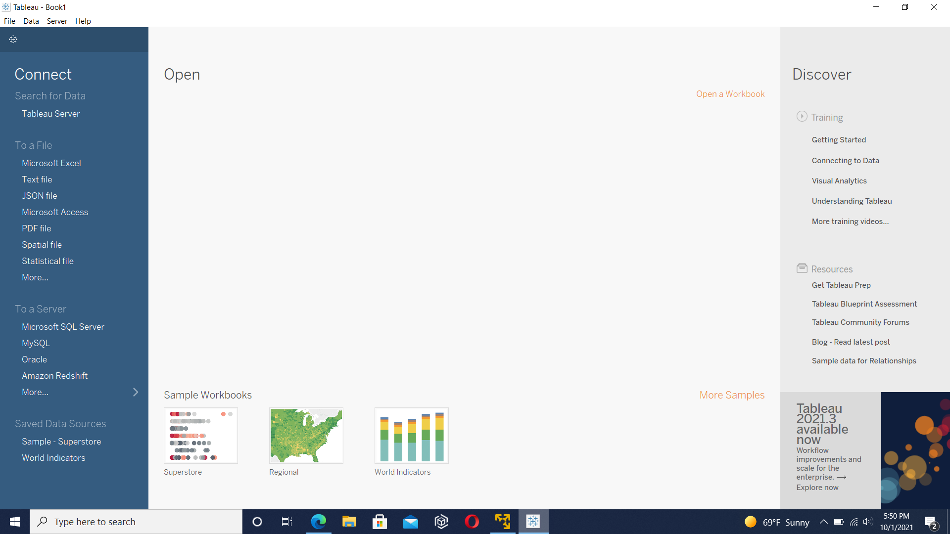
Tableau

Slide 21
Data Wrangling, Cleaning, and plots
http://localhost:8888/notebooks/Final%20Data%20Wrangling%2C%20Cleaning%2C%20and%20plots.ipynb

Slide 22
references
United States Census Bureau. (2020, April). Current Population Survey 2019 Annual Social and Economic (ASEC) Supplement. https://www2.census.gov/programs-surveys/cps/techdocs/cpsmar19.pdf
U.S Bureau of Labor Statistic. (2021, January 22). Unemployed persons by occupation and sex. https://www.bls.gov/cps/cpsaat25.htm
U.S. Bureau of Labor Statistics. (n.d.). Civilian unemployment rate. Retrieved February 13, 2021, from https://www.bls.gov/charts/employment-situation/civilian-unemployment-rate.htm
U.S. Bureau of Labor Statistics. (2020, May). Learn more, earn more: Education leads to higher wages, lower unemployment. https://www.bls.gov/careeroutlook/2020/data-on-display/education-pays.htm
U.S. Bureau of Labor Statistics. (2021, January 27). Concepts and Definitions (CPS). https://www.bls.gov/cps/definitions.htm#unemployed

